Slide 1
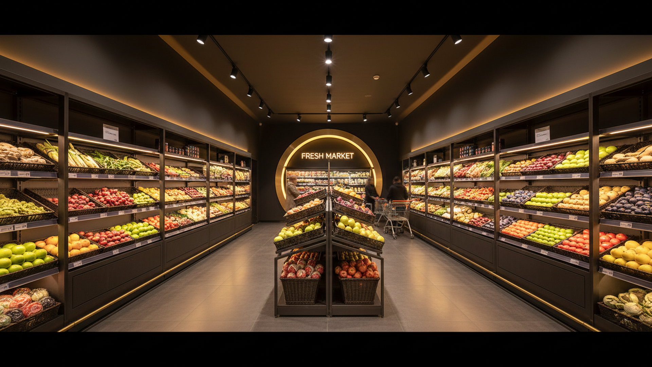
CONCEPT PROPOSAL
Netto 4.0
Redefining the Discount Store
A full concept revamp — assortment, space, and experience — moving beyond SPOT as primary category driver. Target: test store operational within 12 months.
Salling Group · Netto · 2025

Slide 2
Key Questions to Solve
01
How do we redefine category strategy with SPOT no longer as the primary assortment driver?
04
What store layout and customer experience changes best support the 4.0 concept?
02
What assortment changes maximise revenue per sqm and serve everyday shopper needs?
05
How do we ensure supplier and supply chain alignment with the new assortment model?
03
How do we reallocate store space to prioritise fresh, bakery, and convenience categories?
06
What KPIs and success metrics define whether the 4.0 test store delivers the concept?

Slide 3
Strategic Direction: The 4.0 Shift
Four pillars redefining what Netto stands for beyond SPOT-driven footfall
01 Fresh-First Assortment
Elevate fresh produce, dairy, bakery, and ready meals as the primary traffic drivers — replacing SPOT's impulse role with everyday quality.
02 Space Reimagined
Reclaim SPOT floor areas for high-frequency staples, chilled categories, and a frictionless customer flow — fewer SKUs, better productivity per sqm.
03 Value Redefined
Netto's price promise on core staples, reinforced by own-label quality and curated seasonal events — creating loyalty beyond discount promotions.
04 Modern Store Experience
Bright, navigable store design with clear category zoning, digital wayfinding, and checkout efficiency — making Netto the easiest weekly shop.

Slide 4
From SPOT-Driven to Fresh-Led: The Revenue Mix Shift
Projected category revenue contribution — Netto 4.0 vs. current model
–20pp
SPOT share reduction · Year 1 vs Today
+22pp
Fresh & Core uplift · by Year 2 target
Reducing SPOT from 30% to 10% of revenue frees floor space and buying budget for categories that build daily loyalty.
Source: Salling Group internal modeling; Netto 4.0 scenario analysis

Slide 5
12-Month Roadmap to Test Store Launch
Phase 1 — Months 1–3
Phase 2 — Months 4–6
Phase 3 — Months 7–9
Phase 4 — Months 10–12
Design & Planning
Build & Procure
Test & Iterate
Scale Decision
Concept design brief
Category strategy reset
SPOT exit roadmap
Supplier engagement
Store selection & lease
Space planning principles
Assortment finalisation
Supplier contracts signed
Planogram development
Store fit-out begins
Staff training programme
IT & systems config
Soft launch — test store
KPI tracking begins
Customer feedback loop
Assortment fine-tuning
SPOT area conversion
Media & PR campaign
Full launch evaluation
Rollout business case
Next 20 stores identified
Supplier scale planning
Capex approval
4.0 playbook complete
🚀 Test Store Live — Month 12

